Slide 1
MATRAS
Management Training System
“Optimizing Training System for
Human Performance
by Digitalization system”
Ahmad Abdurrahman : DM2260924
Alvany maulana : DM2260925

Slide 2










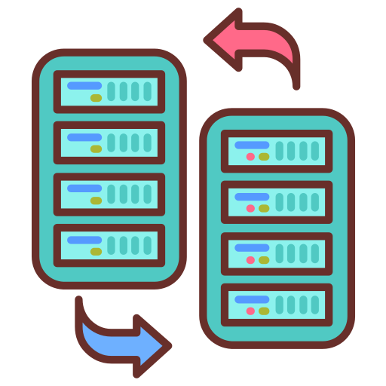










MATRAS
“Optimizing Training System for Human Performance by Digitalization system”
Management Training System
CURRENT PROBLEM
TARGET
WOT
Many participants have passed
the dojo test so it wastes time
1
Efficiency of Inputting Data
Efficient and Effective
Management Training
The data input process is still manual so it is not effective
System that can detect duplicate participants
2
Delay score data so that data
is not real time
3
Secured participant’s history data
There is a repeat of sending participant data through to
HR=>> Muda process
4
Monitoring control by HR directly
GOALS
MATRAS
Reduce man hour with effective work and accuracy programming data.
Management Training System
1
3
4
Create participant imports that can detect duplicate participants
Create a bank participant so that people who pass automatically enter
Export Table by excel
DX
ACTIVITY
TEAM 4
2
5
Make import scores per subject so that it is efficient
Added HR features that can monitor the results of the dojo
Alvany
Maulana
Ahmad
Abdurrahman

Slide 3
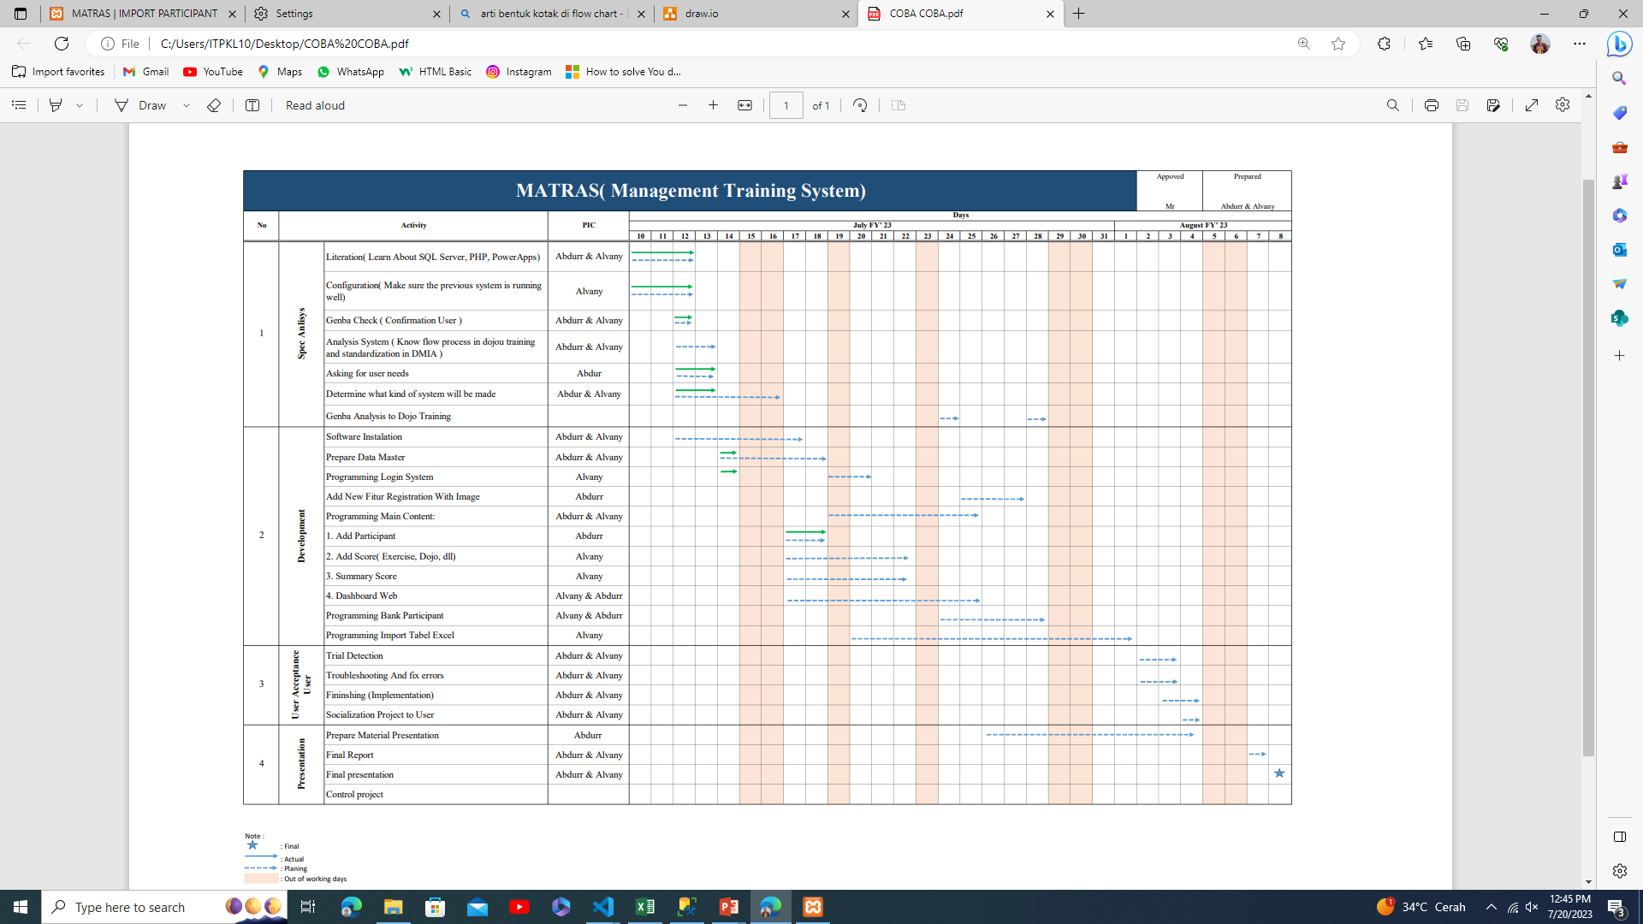
DX TIMELINE
Evaluation

Slide 4







FLOW PROCESS
Currently Process
HRD
TRAINER
01
SPORT
EVALUATION
DOJO PARTICIPANT
Problem User
Fill the MS form
to input personal data
possibility of double training
Evaluation by MS
form as attending
Evaluation
by spreadsheet
Remidial
Transfer participant data by WA Group
02
DOJO
TRAINING
Problem User
OK
NG
Manual Input
The trainer input
the participant data
in summary result
SUMMARY SPORT
Result
Problem User
SUMMARY RESULT
Trainer copy and paste result sport and evaluation
Name filling from participant does not match
NG 2X
PROBLEM
USER
03
Transfer data
by Email to HR
Abnormality
Remedial limits vary by employee type
HR-MCU
NG
04
Result
FAILED
BANK PARTICIPANT
OK
HR confirmation with dojo participants passed

